Slide 1
Introduction to Postman
Erwin Jason Lim

Slide 2
Overview
What is Postman?
What is API?
What is BlackBox Testing?
How does API, Blackbox Testing relate to Postman?
Where to get Postman?
Demo/Hands-on/Questions

Slide 3
What is Postman?
Interactive and automatic tool
Verifying the APIs of your project
Used for BlackBox testing

Slide 4
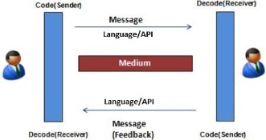
What is API?
API is the acronym for Application Programming Interface.
It is a language structure agreed by two software so that it can communicate with each other.
A simple way of understanding this is, imagine two people communicating.
They need to have a common language structure so that they can understand each other.
In applications, that common language structure is called the API.
e.g. You called the police, they require Name, Address, Emergency Information to be able to help you.
Otherwise they can’t provide you the service you need.

Slide 5
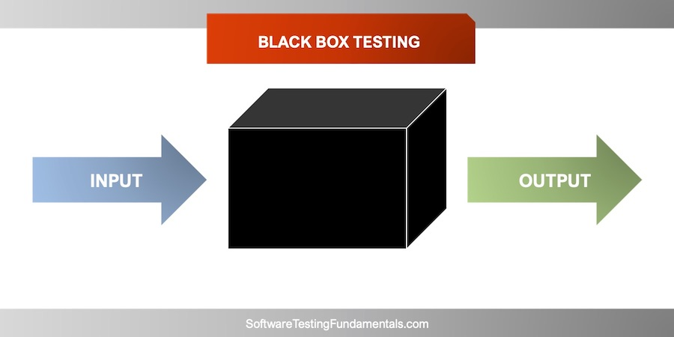
What is Blackbox Testing?
Black-box testing is a method of software testing that examines the functionality of an application without peering into its internal structures or workings
E.g. Is a calculator, we can only test the input and the output of the calculator but not test how the calculator’s inner calculation works.
8/2(2+2) = 16, We input the equation but we do not check which one the calculator calculates first, we only check whether its final output is correct

Slide 6
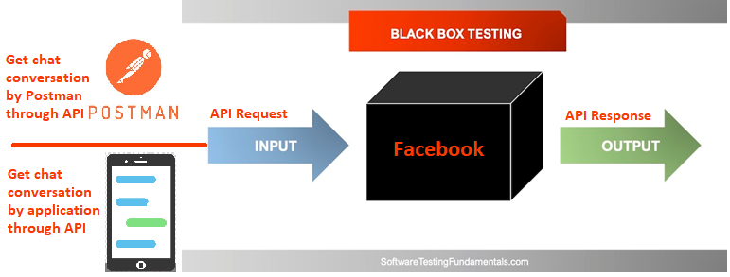
How does API, Blackbox Testing relate to Postman?

Slide 7
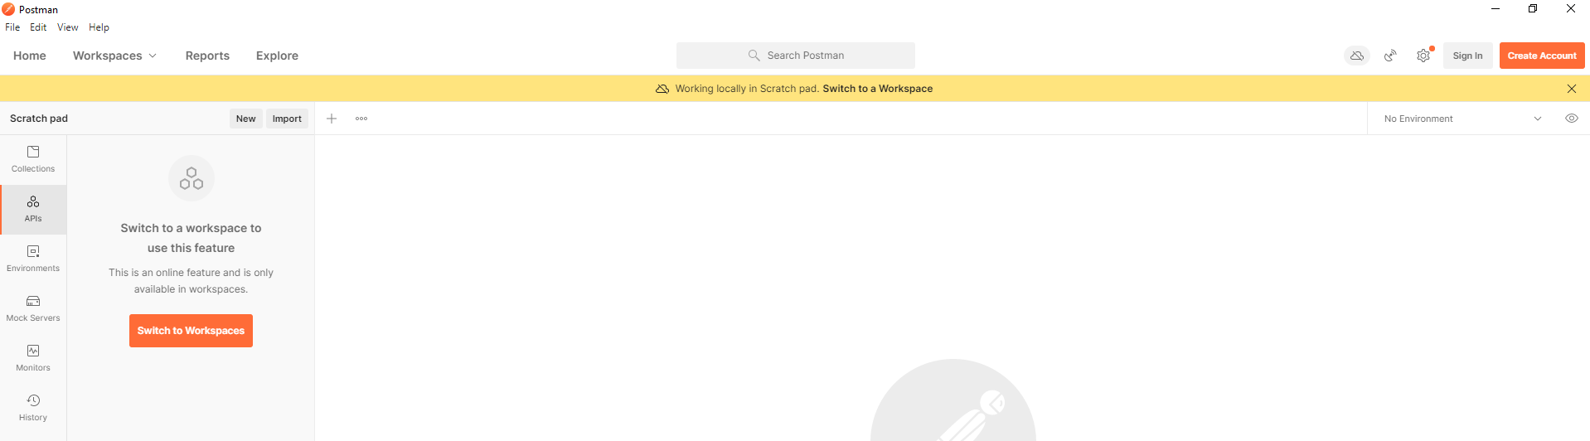
Where to get Postman?
Step 1: Go to https://www.postman.com/downloads/
Step 1 (No Admin Rights, Deprecated): https://chrome.google.com/webstore/detail/postman/fhbjgbiflinjbdggehcddcbncdddomop?hl=en
Step 2: Download and install the software
Step 3: Run the application

Slide 8
Demo/Hands-on/Questions
RESTAPI Server Sample: https://jsonplaceholder.typicode.com/

